Slide 1
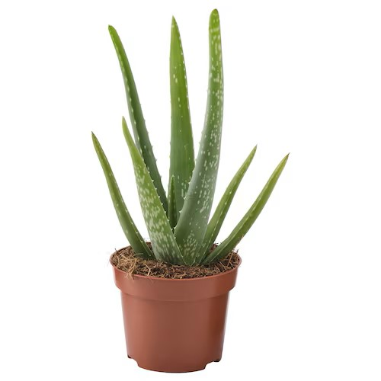
SnapGarden Final Presentation
Projektpraktikum Multimedia
Hayri Altinisik, ge47nij@tum.de
Baran Kilic, ge95bid@tum.de
Kenny Nguyen, ge47wof@tum.de

Slide 2
Project Idea
The Problem:
Beginners struggle to care and maintain healthy plants
Overwatering, pests, and lack of knowledge lead to plant failure
Seasoned Gardeners desire smarter tools
Our Motivation:
Empower plant lovers with AI-powered tools to make plant care effortless
Promote sustainability by encouraging successful plant cultivation
Bridge the gap between technology and nature for eco-conscious living

Slide 3
Key Features
Plant Identification:
Snap a photo of any plant, and our AI identifies it instantly
Provides information like plant type, ideal conditions, and common issues
Health Analysis:
Detect signs of pests, diseases, or poor health through photo analysis
Offers actionable advice for treatment and maintenance
Personalized Watering Schedules:
AI calculates the watering needs of each plant based on species
Sends reminders, so users never miss a watering day
User-Friendly Experience:
Easy-to-navigate interface with tips for beginners and tools for experienced gardeners
Works seamlessly across devices for on-the-go support.

Slide 4
Project Management, Task Distribution
Deep Learning (Baran Kilic)
Dataset Preparation & LLM model Training
Backend (Hayri Altinisik):
Developing the logic for sign-in/sign-up processes and dashboard functionalities
Frontend (Kenny Nguyen):
Implementing a website and a dashboard using templates.

Slide 5
Implementation & Challenges
Deep Learning:
Which Dataset: Baran657/SnapGarden_v0.6
Which model? Model Architecture?: Salesforce/blip2-opt-2.7b Lora finetuned on 0.2 % trainable parameters
Training process? / Performance?: AdamW Optimizer
Website:
Frontend framework: HTML, CSS, JS, Sass, Bootstrap
Used two Templates
Challenges:
Time Management
LLM Challenges
Task Distribution
Skill Issues

Slide 6
Goals & Milestones
Baran Kilic
Kenny Nguyen
Hayri Altinisik
Dataset
LLM Training
Server Preparation
Website
Dashboard
Logo Design
Plant Identification
& Health Assessment
Chat Function
Log in / Sign Up + “Accounts”
Initial Dashboard Logic
Dataset
LLM Training
Website
Dashboard
Logo Design
Plant Identification
& Health Assessment
Chat Function
Log in / Sign Up + “Accounts”
Dashboard Logic

Slide 7
Goals & Milestones
Dataset
LLM Training
Server
Logo Design
Website
Dashboard
Plant Identification
Health Assessment
Chat Function
Log in / Sign Up + “Accounts”
Dashboard Logic (ToDo, Calendar, Table)
Statistics
Presentation + Demo

Slide 8
DEMO

Slide 9
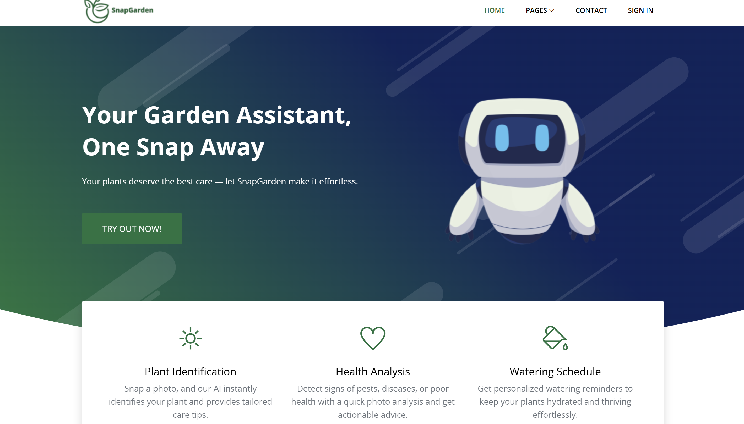
Demo

Slide 10
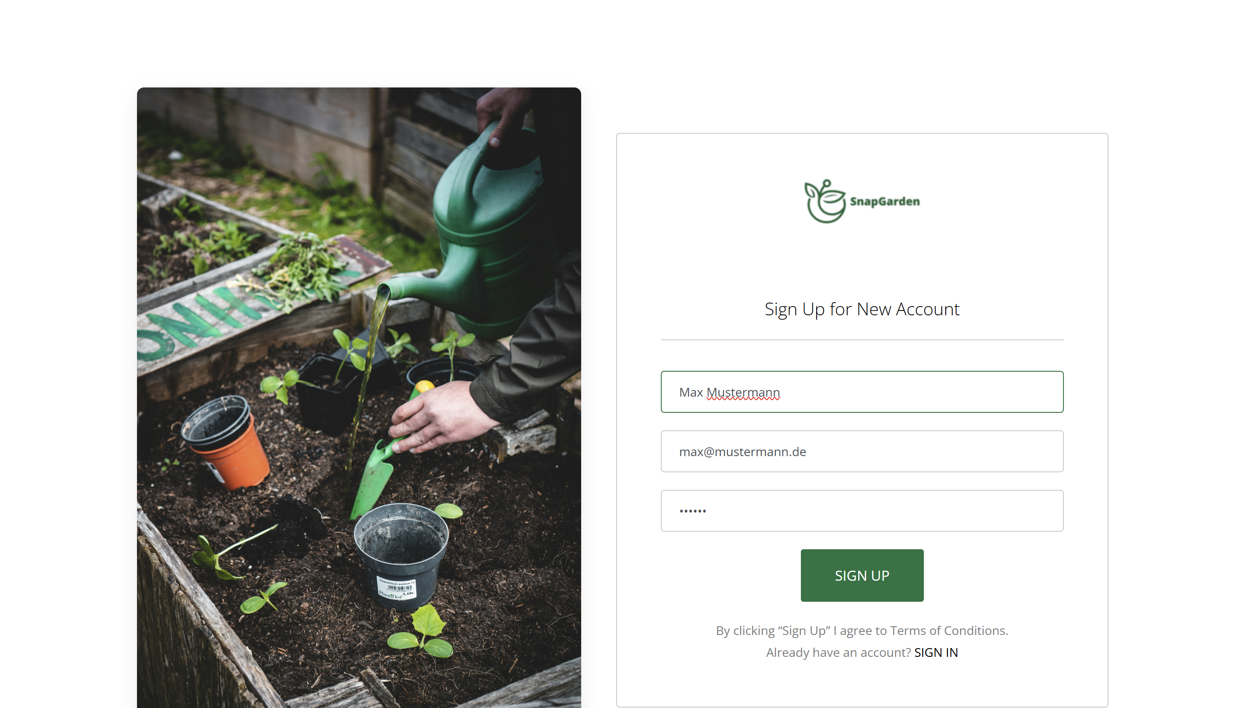
Demo

Slide 11
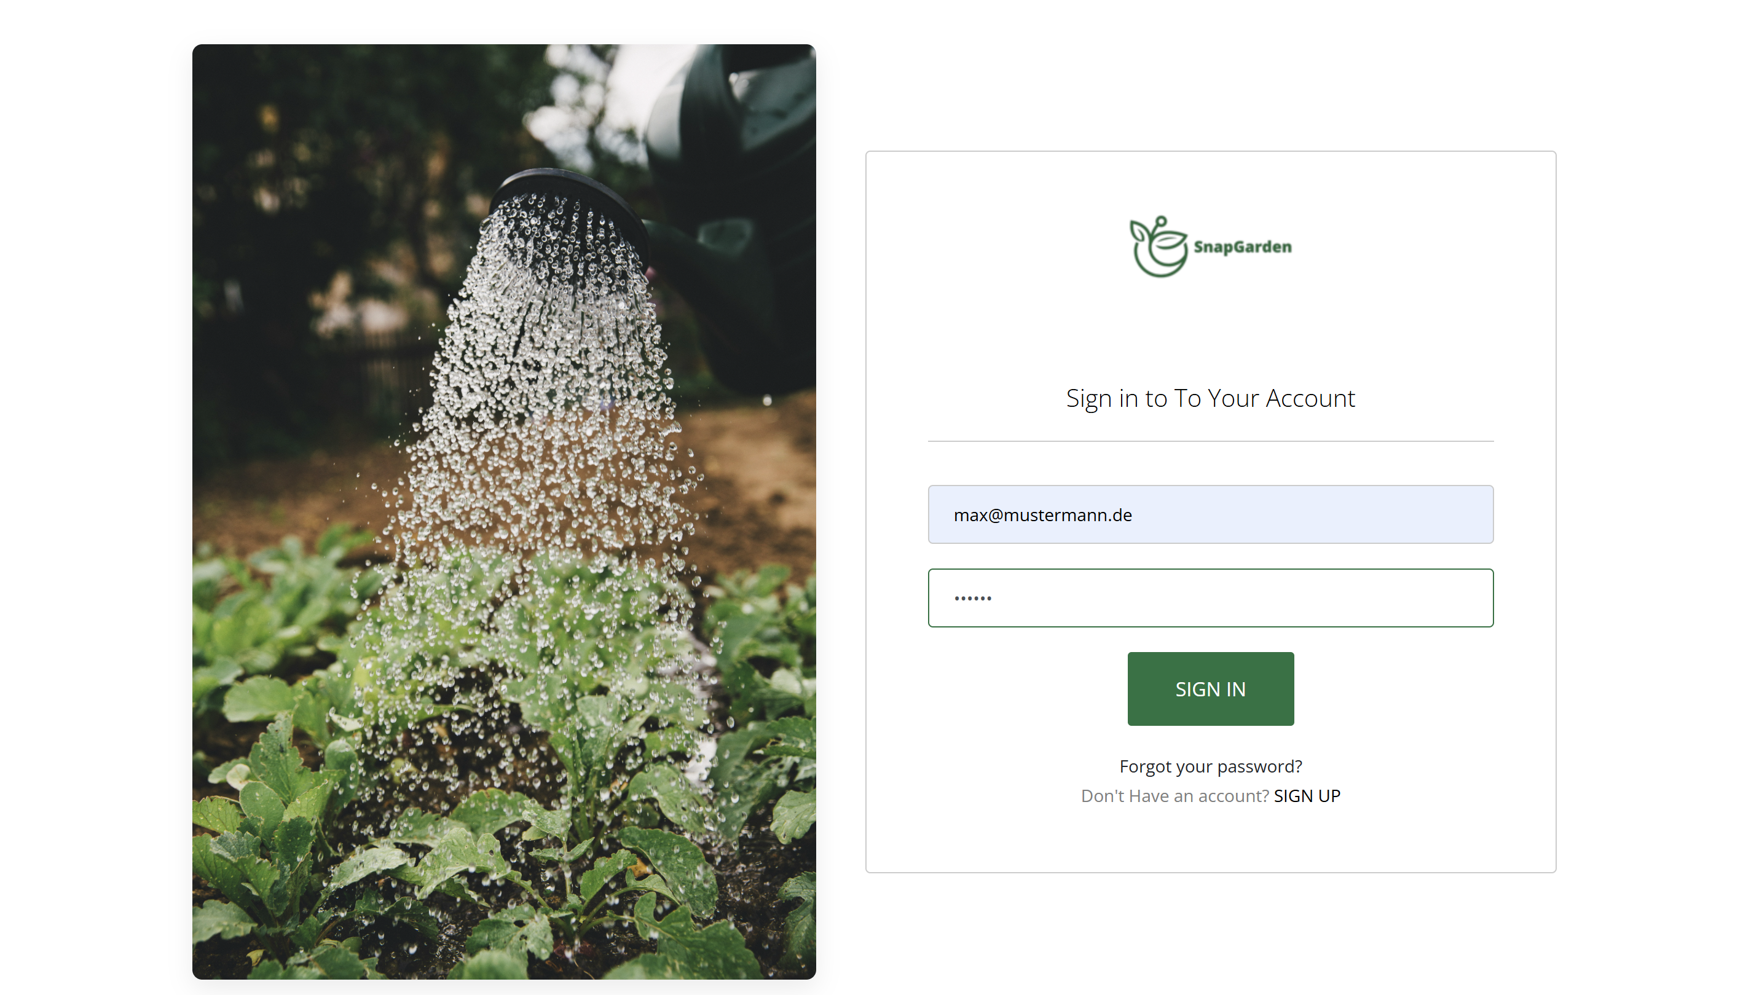
Demo

Slide 12
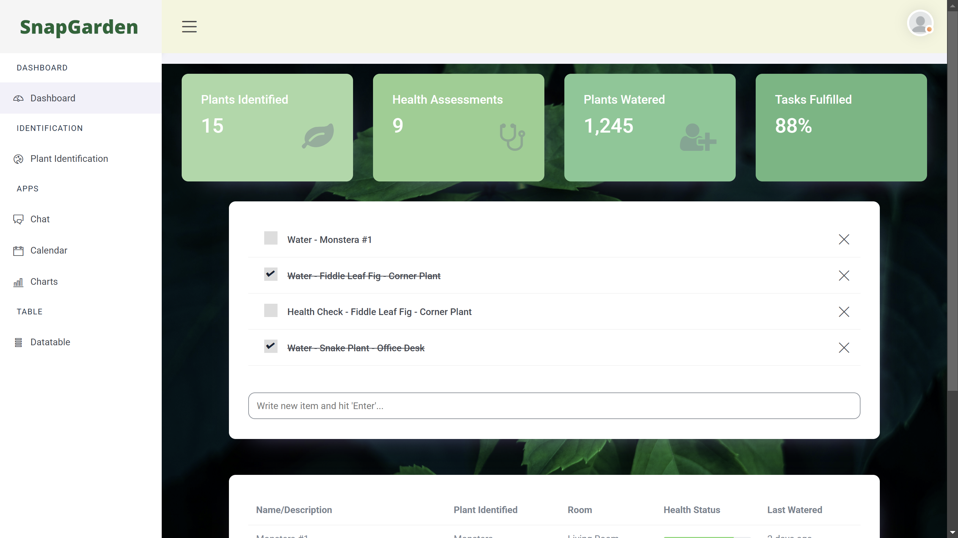
Demo

Slide 13
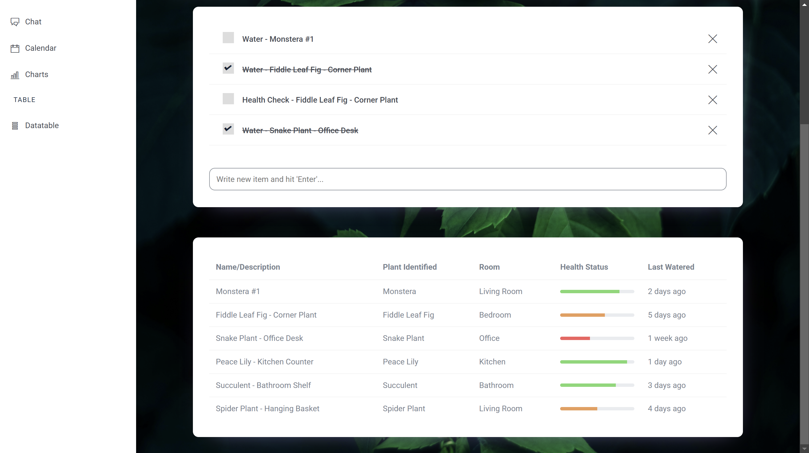
Demo

Slide 14
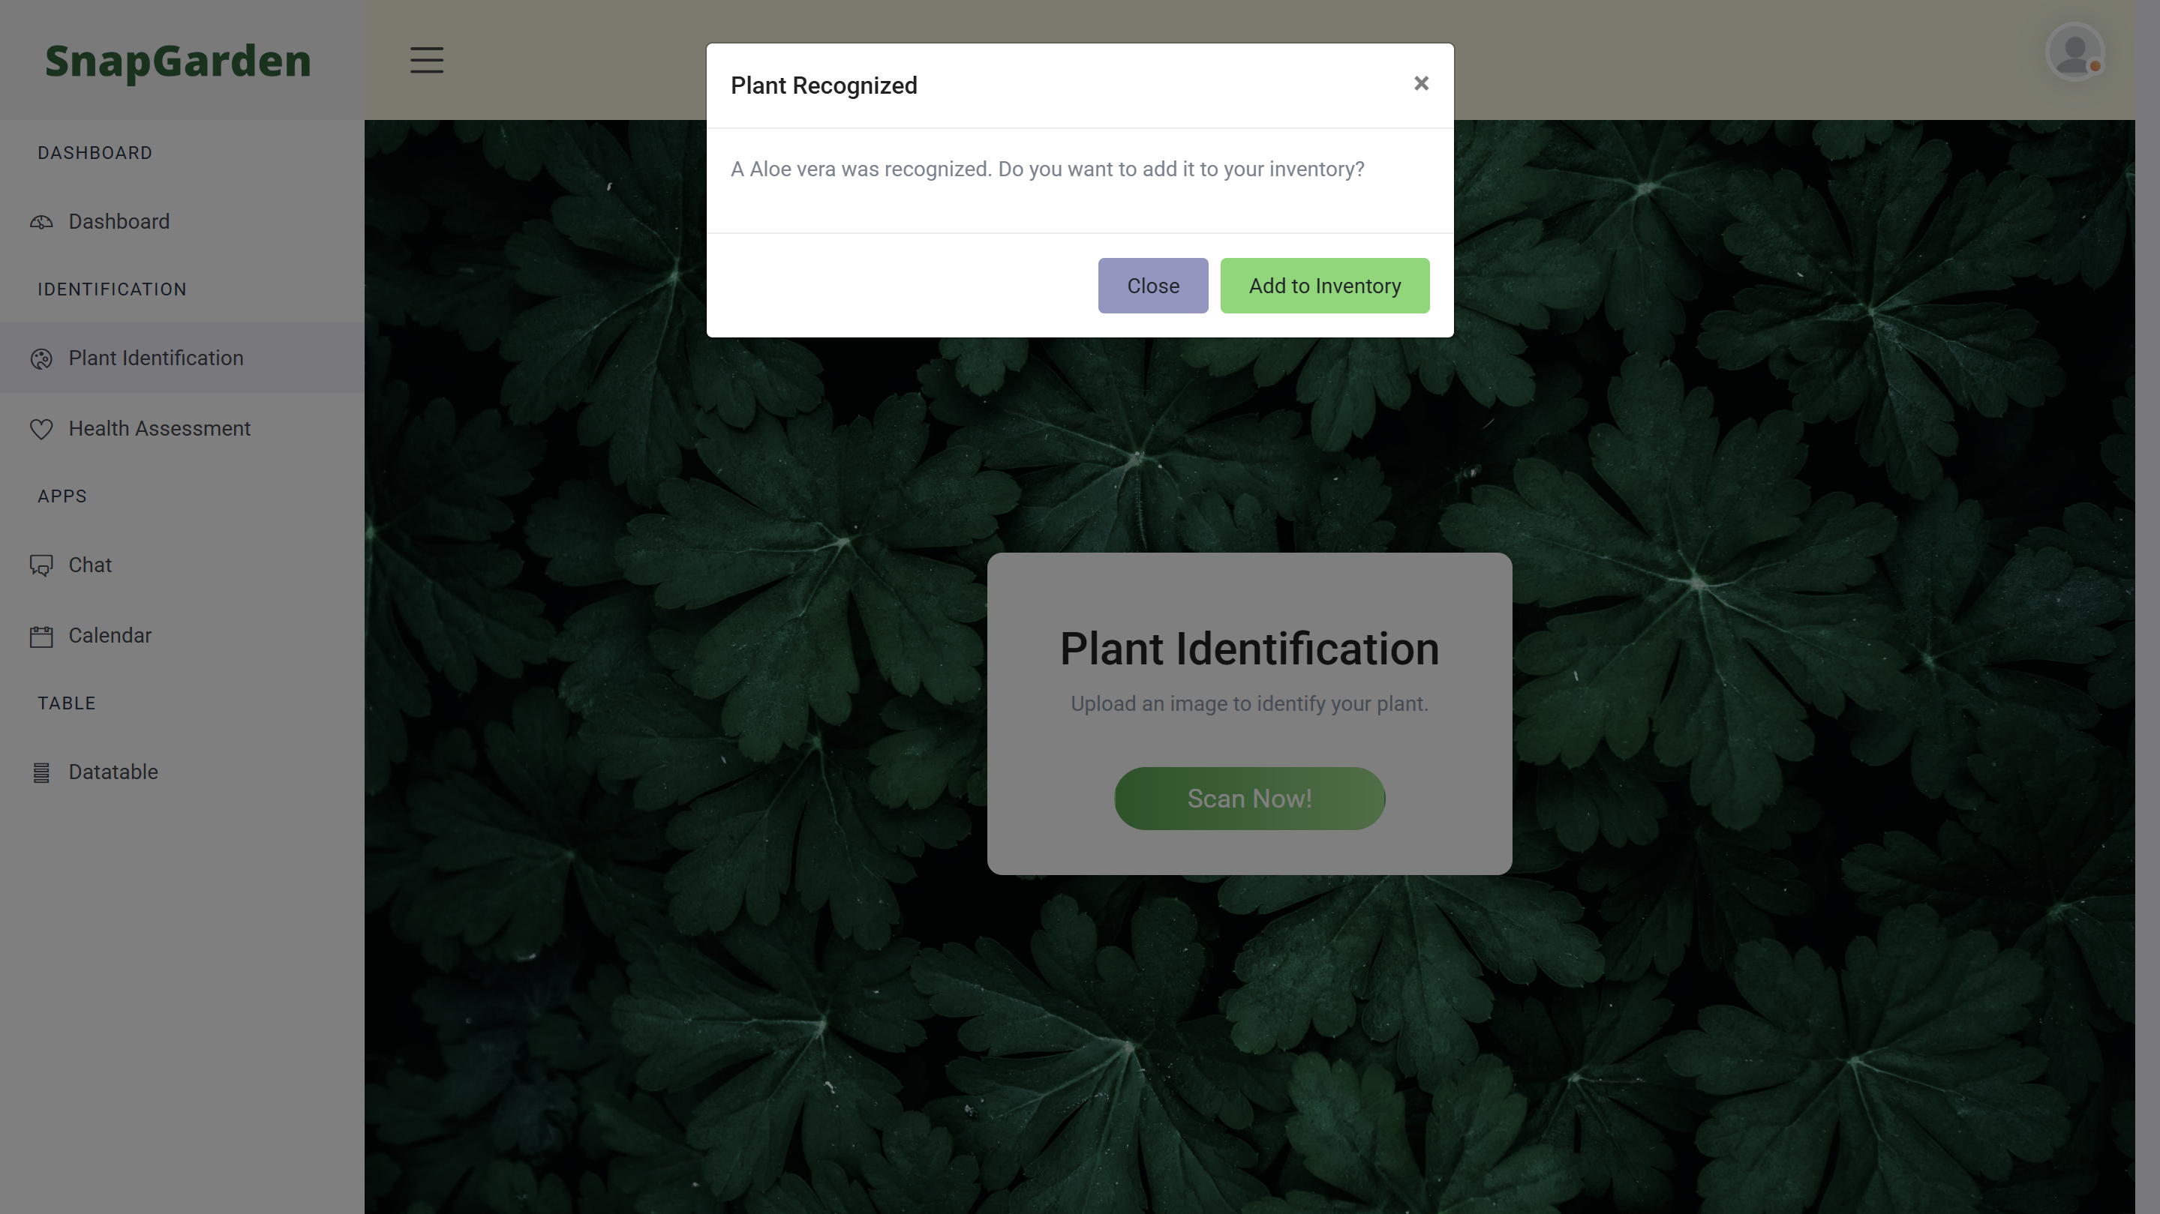
Demo

Slide 15
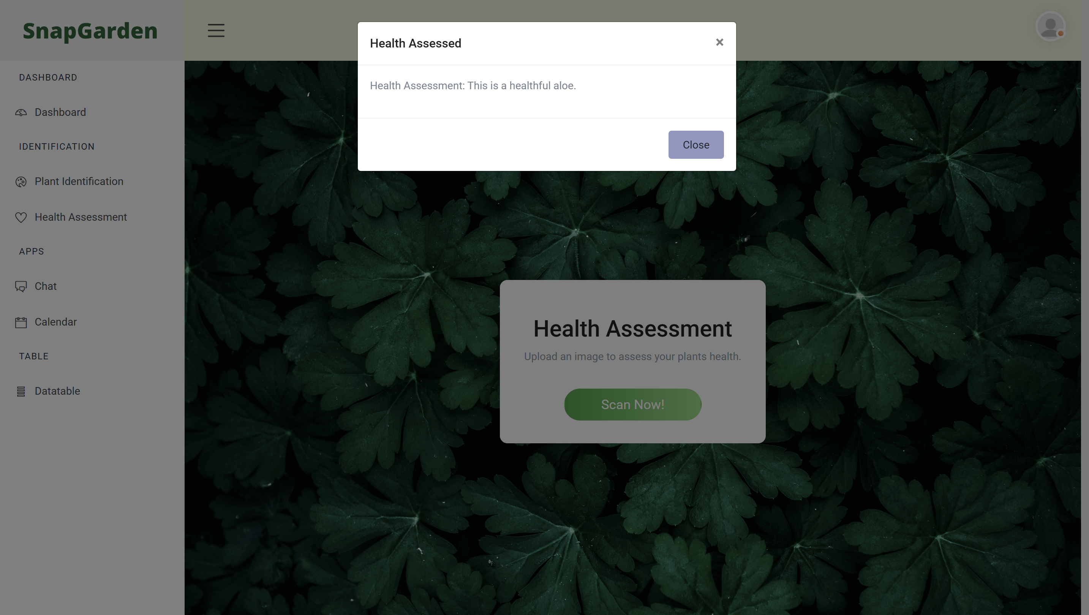
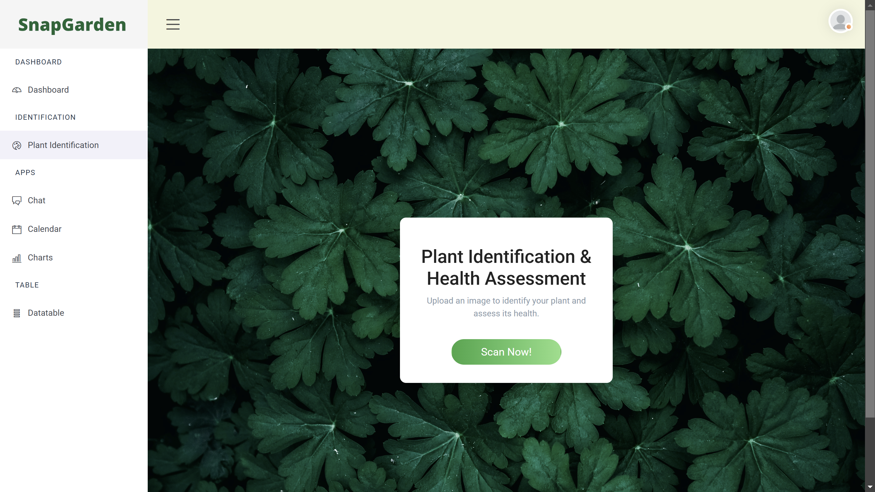
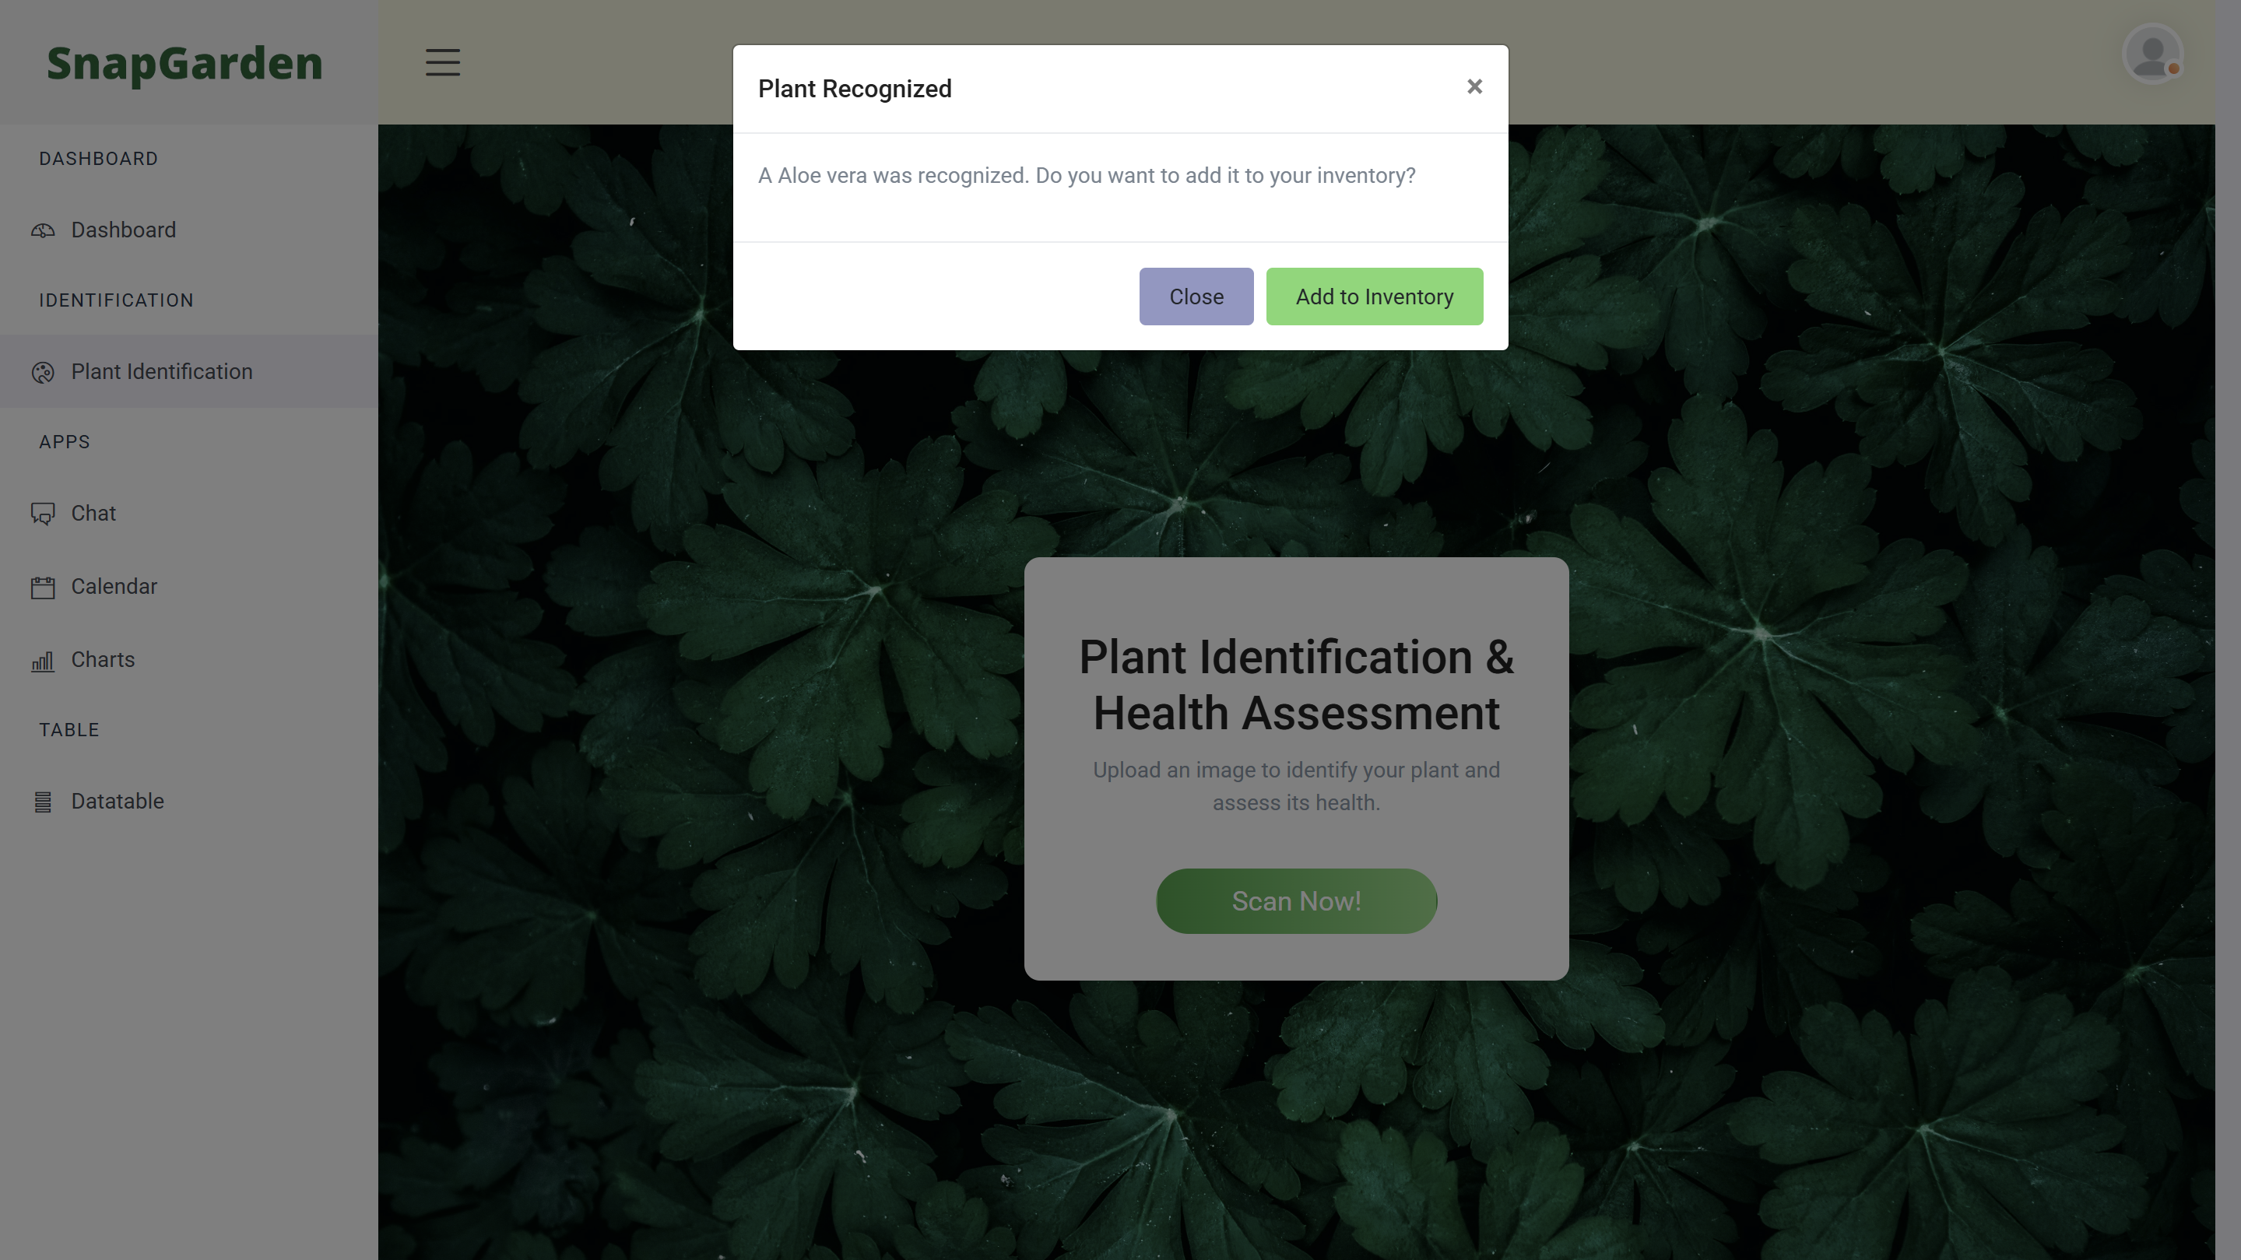

Demo

Slide 16
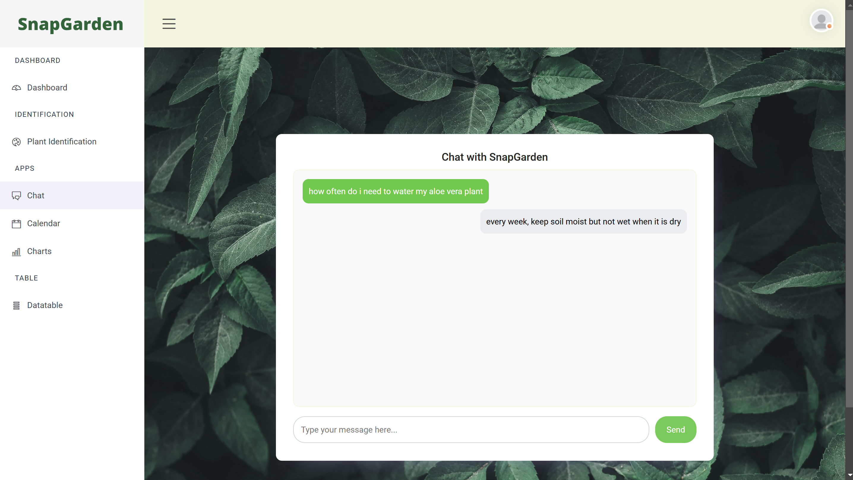
Demo

Slide 17
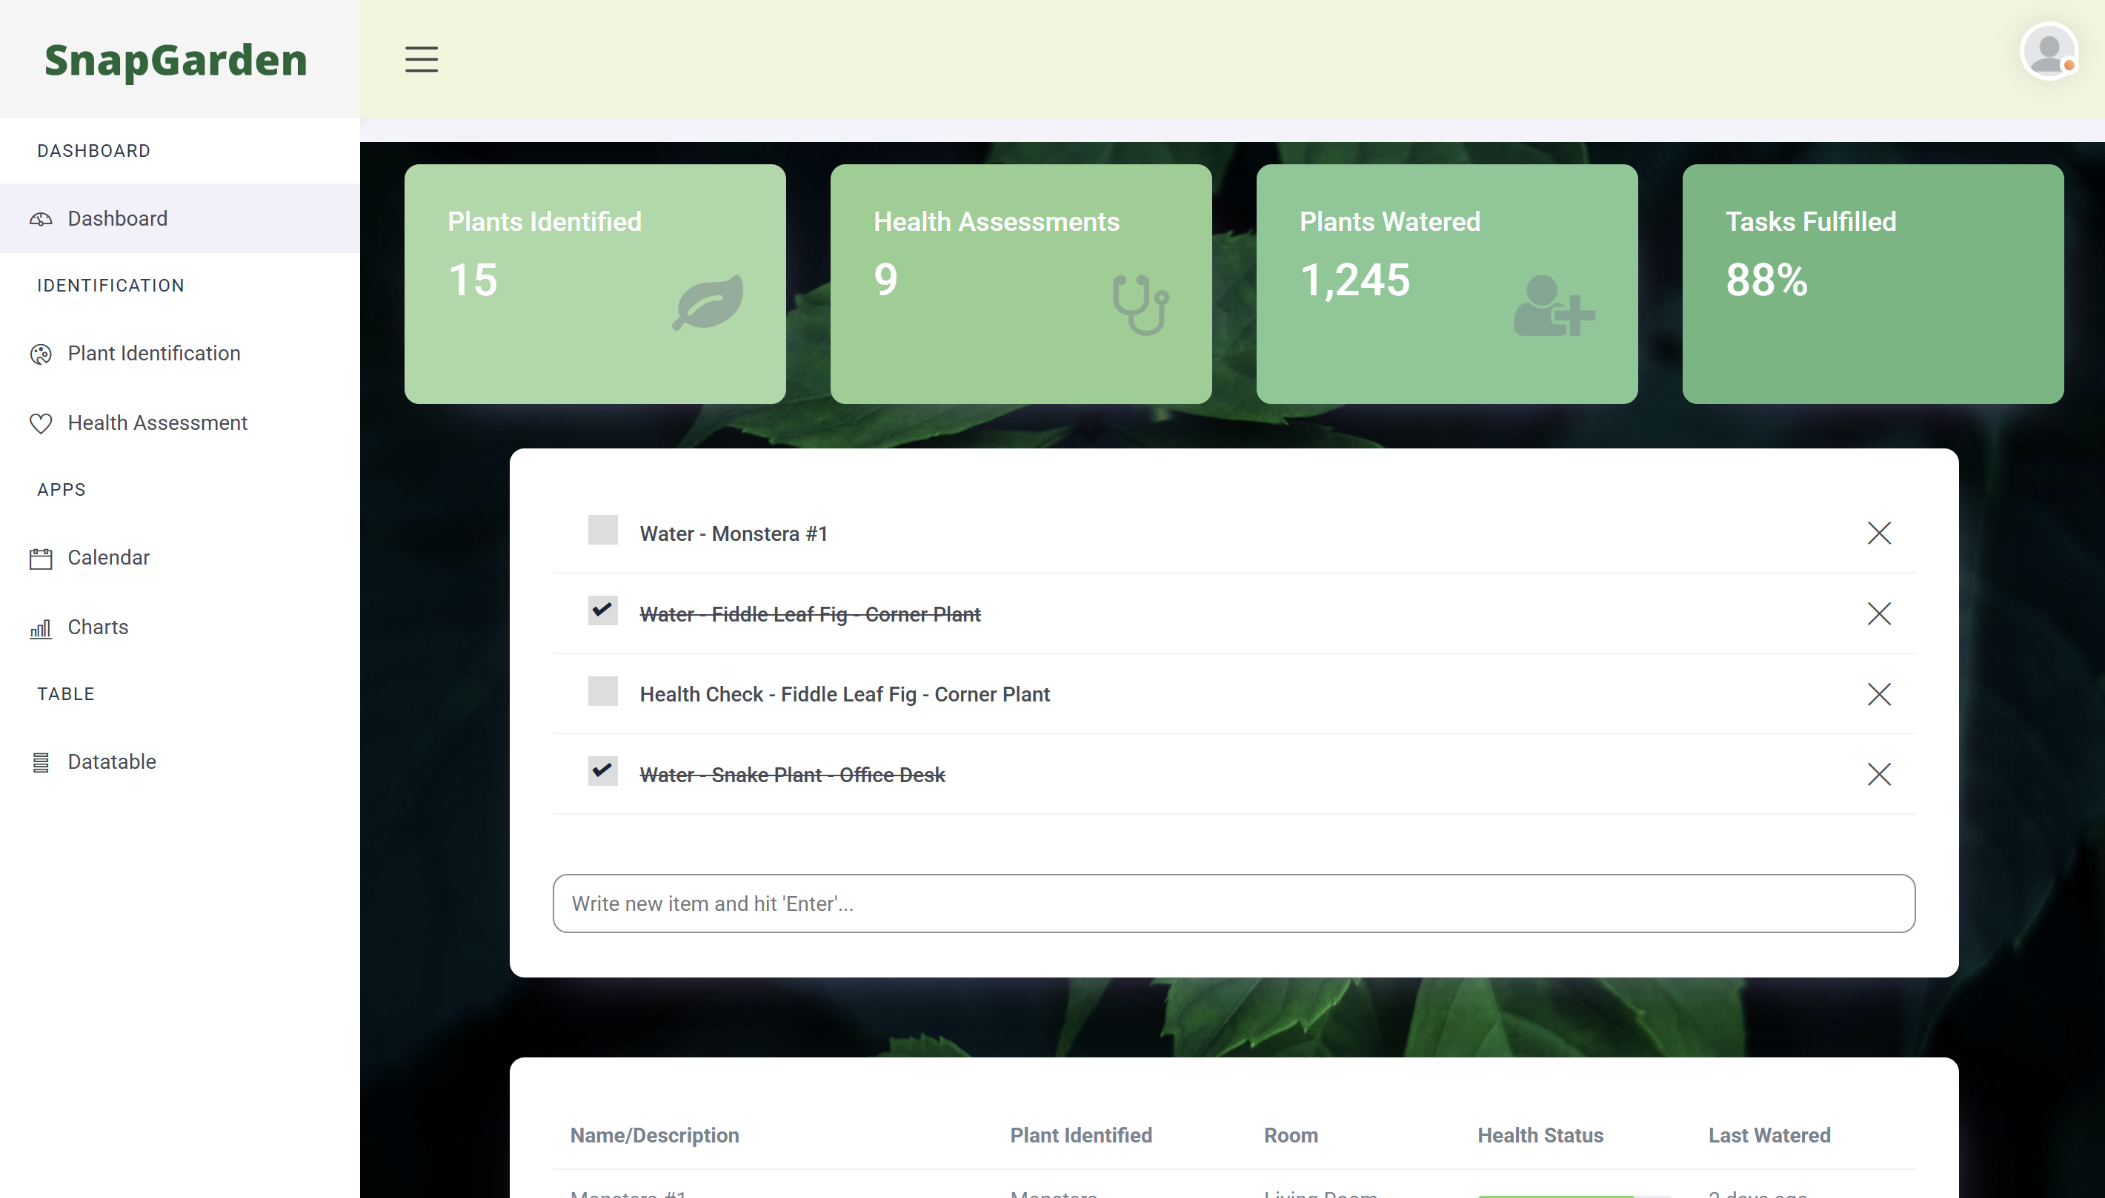
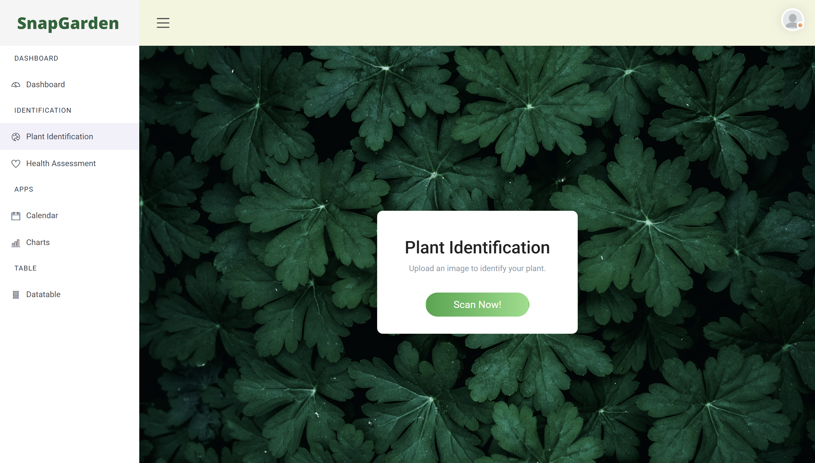
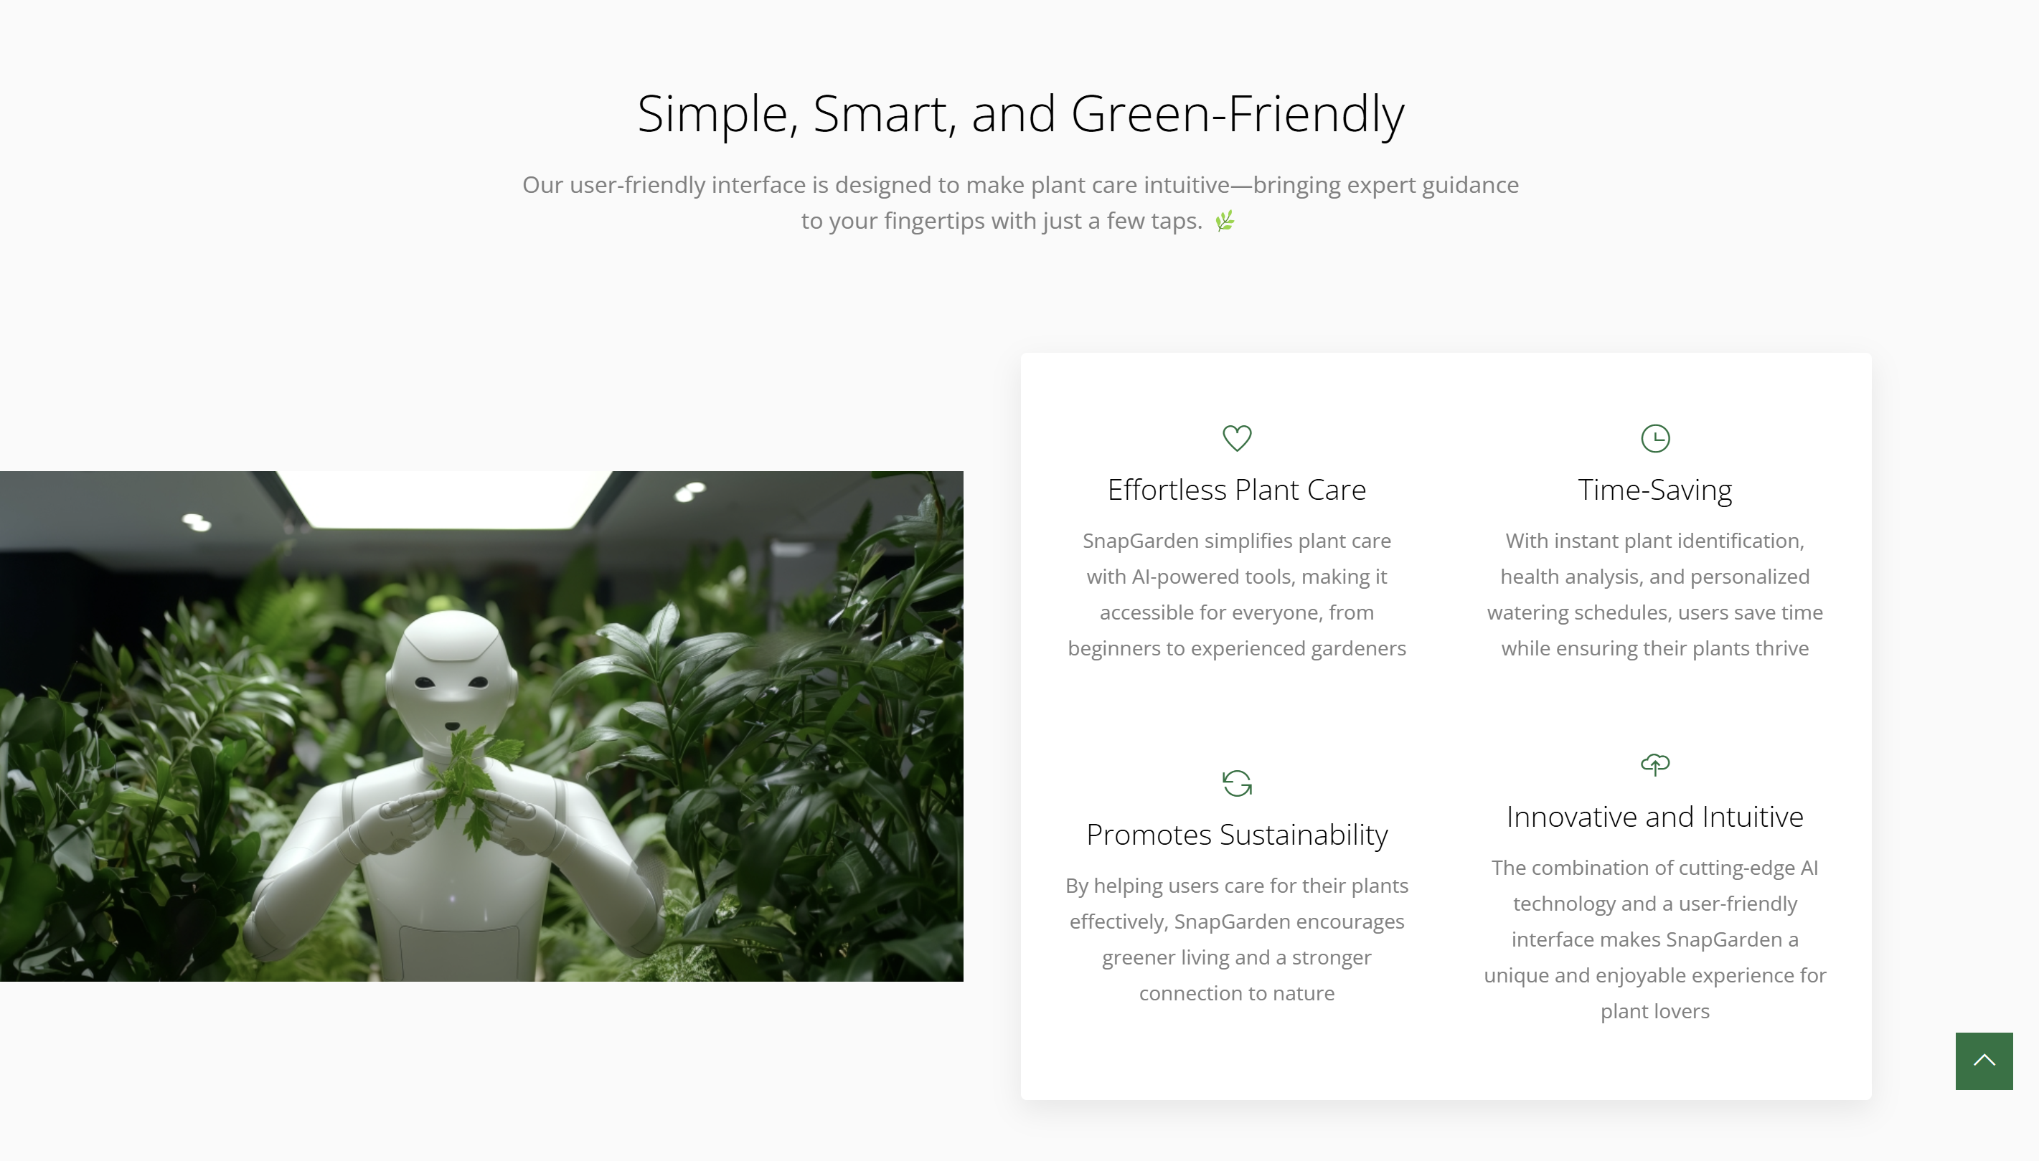
Conclusion

Slide 18
https://149e-138-246-3-41.ngrok-free.app

Slide 19
References
Base model for LLM:
Base Model: Salesforce/blip2-opt-2.7b Lora finetuned on 0.2 % trainable parameters
https://huggingface.co/Salesforce/blip2-opt-2.7b
Templates for Frontend
https://themefisher.com/products/quixlab-bootstrap
https://themefisher.com/products/small-apps-bootstrap

Slide 20
Thank you for your attention

